Slide 1

Capstone Project
Airbnb Bookings EDA
By: Om Birari

Slide 2
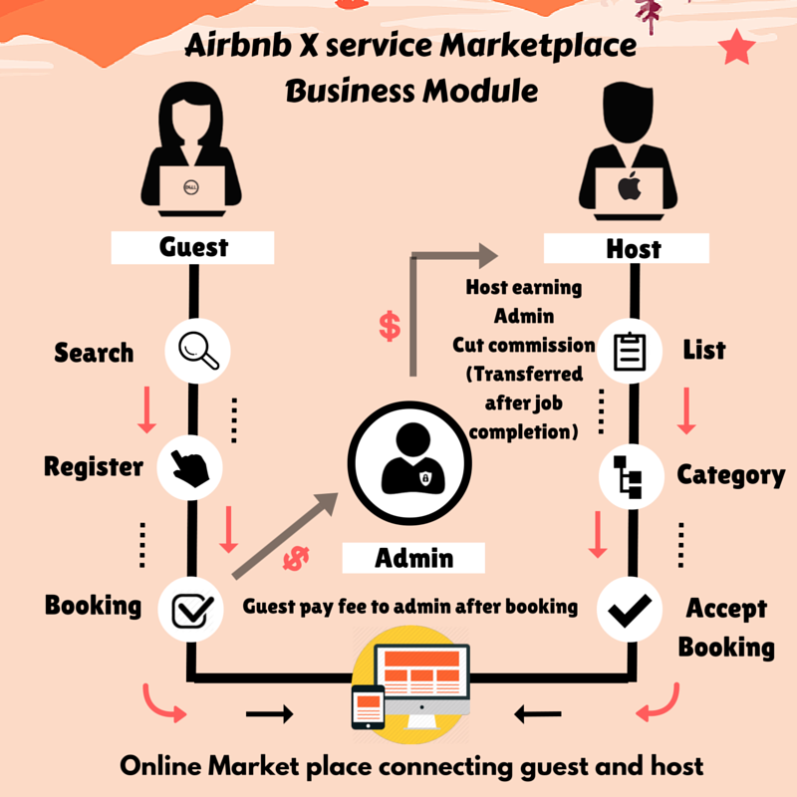
What is Airbnb’s concept? Airbnb acts as a platform for hosts and travelers. Hosts can put up their property for stay, and if someone wishes to stay there, the hosts get rent in exchange. The individuals who stay at Airbnb get a completely different experience by staying close to the locals.

Slide 3

Discussion Points:
We here will be looking on the module for NYC airbnb’s, where we try to capture the idea of certain trends that are followed by the visitors for home renting.
We’ll try to find out key metrics, that influence the listings of the properties on the platform by using some basic EDA.
By reading the dataset, we extract some important leads, like, which locales are busiest, the reviews, pricings, duration for which customers rent, etc
Although such datasets are not much precise and one can only do so much, these turn out to be very crucial for the company.

Slide 4
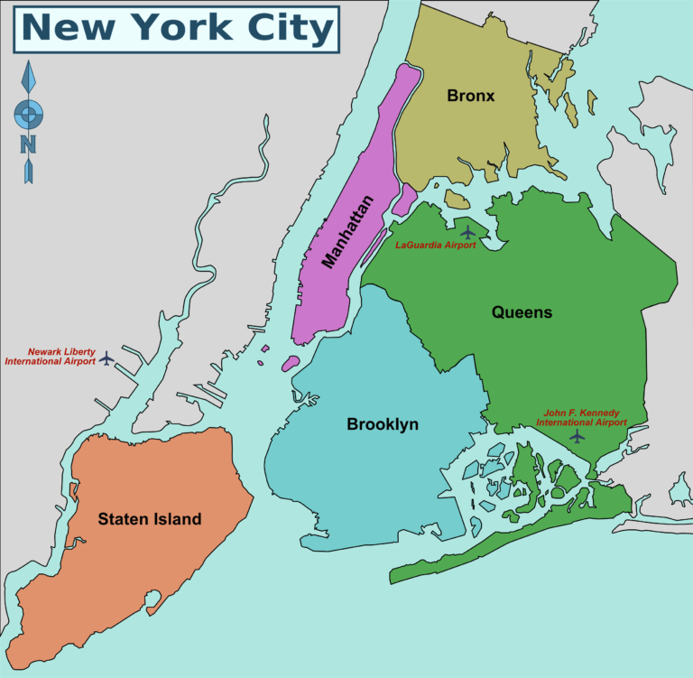

Slide 5
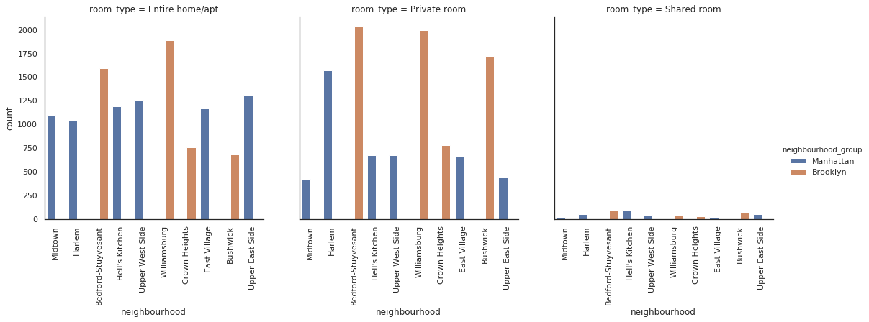
A plot for the type of rooms that visitors tend to go for in the locales.

Slide 6

WHY they LOVE ENTIRE PLACES No hosts watching your every move Make as much noise as you want Wear what you want No sharing the tv You can chill out and relax. There’s no interaction
WHY they LOVE PRIVATE ROOMS
They are super cheap!
Enjoy guest interaction
Breakfast is often included for free
Some love meeting new people when travelling
Your host knows the area and has great advice of things to see

Slide 7
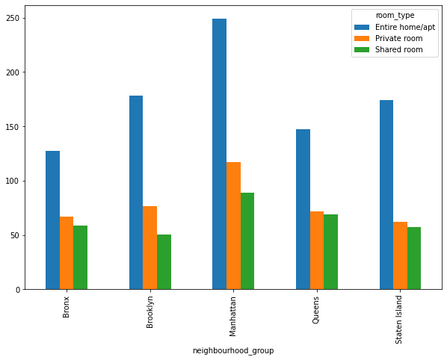
Manhattan’s average price of Entire home is highest comapred to other locations. Average price of shared rooms are lowest in Brooklyn. Queens, Bronx and Staten Island share almost the same price for shared room and private rooms, ie. 50usd.

Slide 8
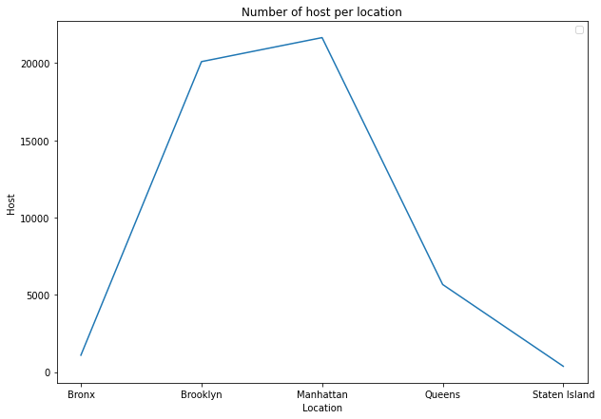
As we can see Manhattan and Brooklyn are the most preferred locales by hosts. Bronx and Staten island are less preffered Reason assumption: For being part of NYC, it lacks culture, open-mindedness and enough interesting things to do. Although close to all that Manhattan had to offer, getting there is a long commute, traffic is awful, public transportation is sorely lacking and anytime you want to drive off the Island, you pay a significant toll.

Slide 9
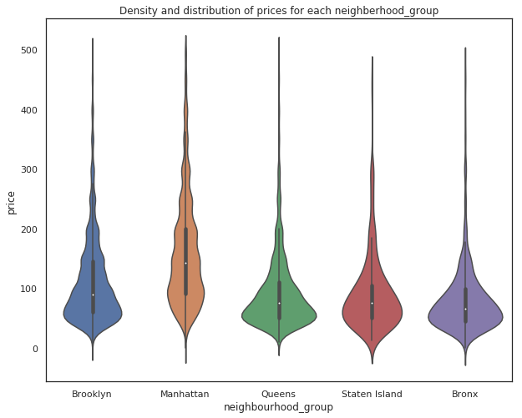
Queens and Bronx have flexible and cheap prices for rents. Manahttan and Brooklyn whereas have more places that are expensive and even go around 500$.

Slide 10
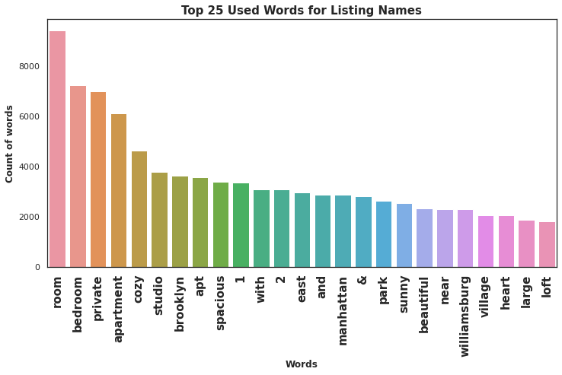
As you create a new listing, writing a catchy Airbnb title is the key to maximizing your bookings. Not only will a better title rank higher in the Airbnb search results, but you’ll also generate some immediate interest from potential guests. That’s why your Airbnb title is one of the most critical aspects of your Airbnb listing.

Slide 11
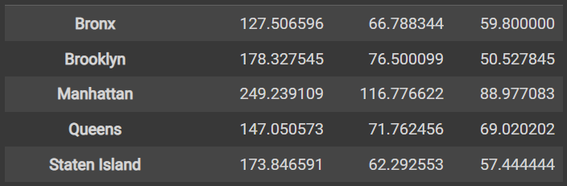
Average Price per Locales:
Locality
Entire home/apt Private room Shared room

Slide 12
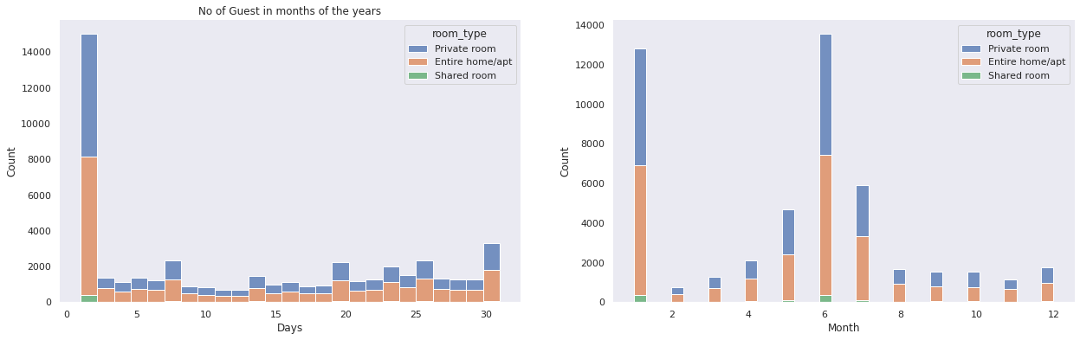
Time of the year when Guests visit more and the type of room they choose:

Slide 13

How can the marketing strategy improve: 1)Make Your Property Stand Out Above the Competition 2)Use Correct and Dynamic Pricing to Improve Your Occupancy Rate 3)Reach Your Guests with Strategic Use of Different Marketing Channels 4)Know Where It Makes Most Sense to List Your Property

Slide 14
Analysis: 1)Most people opt for private rooms/homes. 2)Visitors tend to live less time in private rooms compared to Entire Houses/Apratments. 3)Visitors look for cheap places. 4)It'd be a better if we had avg guest ratings of a property, that would be beneficial in understanding the property more and could also be a factor in deciding price (a low rated property tends to lower their price) 5)Manhattan and Brooklyn are the two distinguished, expensive & posh areas of New York. 6)Though location of property has high relation on deciding its price, but a property in popular location doesn't. It will stay occupied in most of the time.

Slide 15


